Slide 1
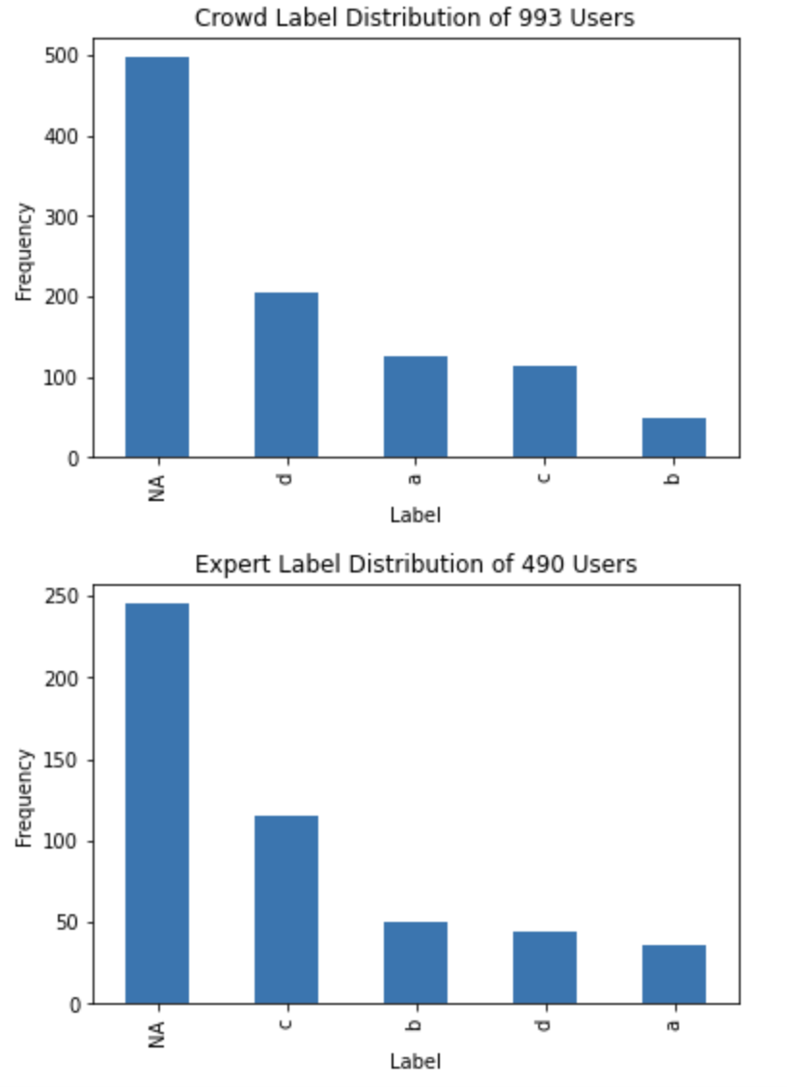
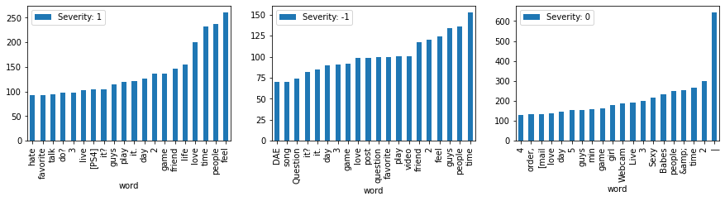
Screening for Suicidality in Social Media Using Semi-Supervised Learning and Sentiment Analysis
ABSTRACT
BASELINE IMPLEMENTATION
MODEL + SENTIMENT
EVALUATION + RESULTS
EXPLORATORY DATA ANALYSIS
FUTURE WORK
Sagar Saxena, Sathvik Ravi, Sriv Srinivasan
University of Maryland, College Park
When performing and EDA on our dataset, we notice that the distribution of users classification on the crowdsourced data vs. expert data have differing distributions. To translate our data to have more consistent distributions for training purposes, we have designated A and B as low severity and C and D as high severity (see figure below for distribution).
In an age where social media is increasingly becoming a place to share one's thoughts anonymously, the posts on these social media platforms have varying levels of seriousness. In order to help identify users who are at a severe risk of suicidality, we have created a semi-supervised learning approach that employs a user’s Reddit posts to classify that user’s risk of suicidality. Our approach builds off of a baseline DistilBERT model by using added input sentiment generated from an LSTM model and emotion labels from a pre-trained DistilBERT model to achieve F1 score of .79.
We fine tune a DistilBERT model which concatenates sentiment and emotion features to a hidden layer to produce output logits. Then we apply the same decision tree thresholding on the maximum suicidality probability.
As a baseline implementation, we propose training a DistilBERT model on both SuicideWatch and Non-SuicideWatch posts. We prepare the training data by classifying all the posts of a given user as the ground truth label assigned to that user in our ground truth. We trained our model for 1 epoch on crowd-sourced examples and evaluated on expert examples. Then we take the softmax of the output logits to get the probability of suicidality classification. For each user, we then take the maximum suicidality probability over all their posts and apply thresholding using a decision tree to classify suicidality for each user.
Since our models output predictions on how strongly a user’s post is at low or high risk of suicide, we take these outputs and train them on a Decision Tree in order to determine a threshold that separates low from high risk for each user. Then to classify each user, we take that user’s highest post score and evaluate against this threshold.
Pre-trained Tokenizer
Model | F1-Score | Accuracy
Baseline | 0.78 | 0.66
Sentiment | 0.79 | 0.65
Our training and testing data consists of Reddit users’ posts on both SuicideWatch and Non-SuicideWatch Subreddits. For each of these users, a ground truth label is stated that determines whether the user is at low (A), moderate (B, C), or high (D) risk for suicidality. These labels are assigned by either experts or through crowdsourced means.
+
DistilBERT Hidden Layer
Sentiment + Emotion Features
Output Neuron
Softmax
Many suicidal users tend to be suicidal for a certain period of time rather than through their whole Reddit post history. We would need to improve our method by assigning different severities to each post depending on the content. In future work, we should improve the sentiment detection of these models given our specific time domain.
Decision Tree: Threshold = t
Low Severity (0)
High Severity (1)
Notes:
Flair Library - LSTM to do pos, neg, neutral
HuggingFace Model for Emotional sentiment
https://huggingface.co/bhadresh-savani/distilbert-base-uncased-emotion
Future Work - how do we aggregate an entire history of a user
Pre-trained models weren’t trained on social media examples
Add an evaluation section

